Slide 1
Credit Card Fraud Detection
TOPIC:-

Slide 2
CONTENTS:
Introduction
Literature Review
Objective
Methodology
Data Visualization
Conclusion
Reference

Slide 3
INTRODUCTION TO CREDIT CARD
FRAUD:
Credit card fraud refers to the unauthorized use of someone's credit card information for financial gain. It can occur in various ways, such as stolen credit card details, skimming, phishing, and other fraudulent activities. Credit card fraud can lead to financial losses for both individuals and businesses.
It is one of the most common types of fraud worldwide and accounts for billions of dollars in losses annually.

Slide 4
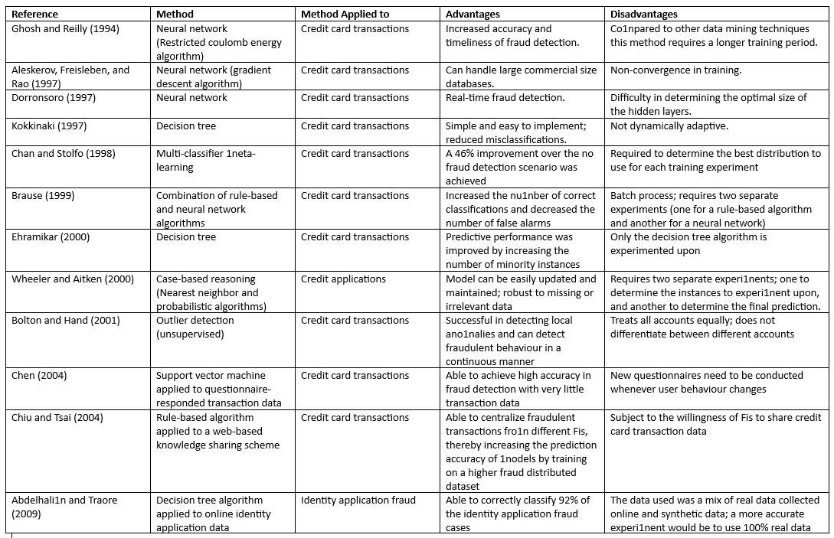
LITERATURE REVIEW:

Slide 5
OBJECTIVE:
The objective of credit card fraud detection system using machine learning is to develop a predictive model that can effectively identify fraudulent credit card transactions from legitimate ones in real-time.
The system aims to minimize the risk and losses of credit card companies and their customers by accurately detecting and preventing fraudulent transactions.
The machine learning algorithm is trained on a large dataset of credit card transactions, and it learns to recognize patterns and anomalies that may indicate fraudulent activities.
The ultimate goal is to minimize losses for credit card companies and protect the financial security of cardholders.

Slide 6
METHODOLOGY:
We collected the data set and imported it in Jupyter Notebook.
Then we removed the missing values, outliers, and inconsistencies in the data.
Then we split the processed data into training and testing data. The training data is used to build the model, while the testing data is used to evaluate the performance of the model.
We applied machine learning algorithms such as logistic regression, random forest & K-means clustering to build the model.
The performance of the model is evaluated using evaluation metrics such as accuracy, precision, recall, F1 score, and AUC-ROC.

Slide 7
ALGORITHM:
Logistic Regression:
Logistic regression predicts the output of a categorical dependent variable. Therefore the outcome must be a categorical or discrete value. It can be either Yes or No, 0 or 1, true or False, etc. but instead of giving the exact value as 0 and 1, it gives the probabilistic values which lie between 0 and 1.
In Logistic regression, instead of fitting a regression line, we fit an "S" shaped logistic function, which predicts two maximum values (0 or 1).
Logistic Regression can be used to classify the observations using different types of data and can easily determine the most effective variables used for the classification.

Slide 8
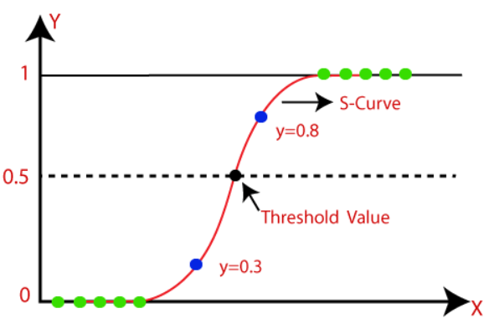


Logistic Regression:
The image is showing the logistic function.
We know the equation of the straight line can be written as:
In Logistic Regression y can be between 0 and 1 only, so for this let's divide the above equation by (1-y):
But we need range between -[infinity] to +[infinity], then take logarithm of the equation it will become:

Slide 9
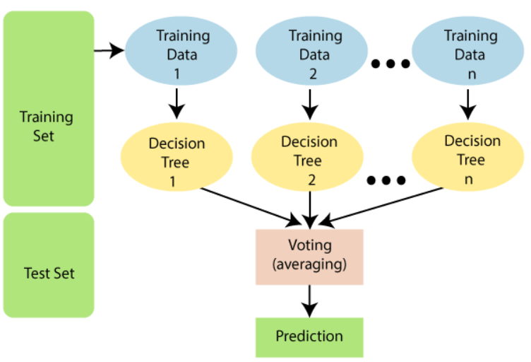
RANDOM FOREST:
Random Forest is a classifier that contains a number of decision trees on various subsets of the given dataset and takes the average to improve the predictive accuracy of that dataset.
Instead of relying on one decision tree, the random forest takes the prediction from each tree and based on the majority votes of predictions, and it predicts the final output.
The diagram explains the working of the Random Forest algorithm.

Slide 10
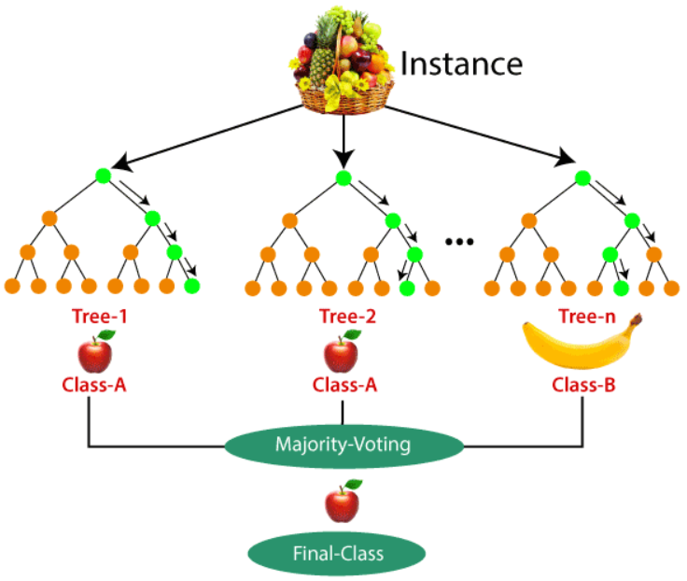
RANDOM FOREST:
EXAMPLE:
Suppose there is a dataset that contains multiple fruit images. So, this dataset is given to the Random forest classifier. The dataset is divided into subsets and given to each decision tree. During the training phase, each decision tree produces a prediction result, and when a new data point occurs, then based on the majority of results, the Random Forest classifier predicts the final decision.

Slide 11
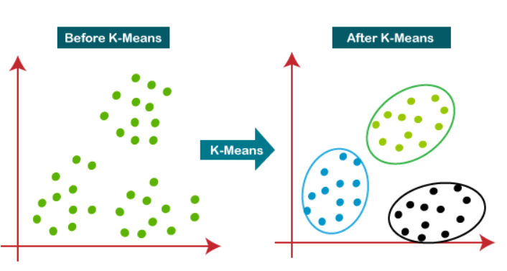
K-MEANS CLUSTERING:
It is an iterative algorithm that divides the unlabeled dataset into k different clusters in such a way that each dataset belongs only one group that has similar properties.
The k-means clustering algorithm mainly performs two tasks:
Determines the best value for K center points or centroids by an iterative process.
Assigns each data point to its closest k-center. Those data points which are near to the particular k-center, create a cluster.

Slide 12
K-MEANS CLUSTERING:
ELBOW METHOD:
This method uses the concept of WCSS value. WCSS stands for Within Cluster Sum of Squares, which defines the total variations within a cluster. The formula to calculate the value of WCSS (for 3 clusters) is given below:
In the above formula of WCSS,
∑Pi in Cluster1 distance(Pi C1)2: It is the sum of the square of the distances between each data point and its centroid within a cluster1 and the same for the other two terms.

Slide 13
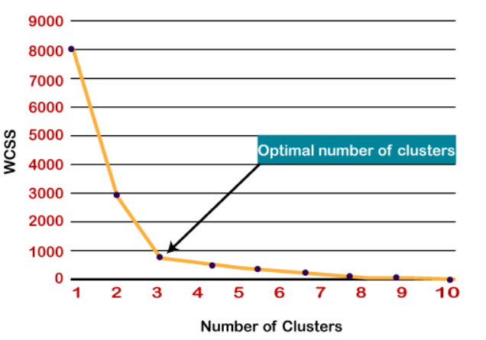
K-MEANS CLUSTERING:
ELBOW METHOD:
To find the optimal value of clusters, the elbow method follows the below steps:
It executes the K-means clustering on a given dataset for different K values (ranges from 1-10).
For each value of K, calculates the WCSS value.
Plots a curve between calculated WCSS values and the number of clusters K.
The sharp point of bend or a point of the plot looks like an arm, then that point is considered as the best value of K.

Slide 14
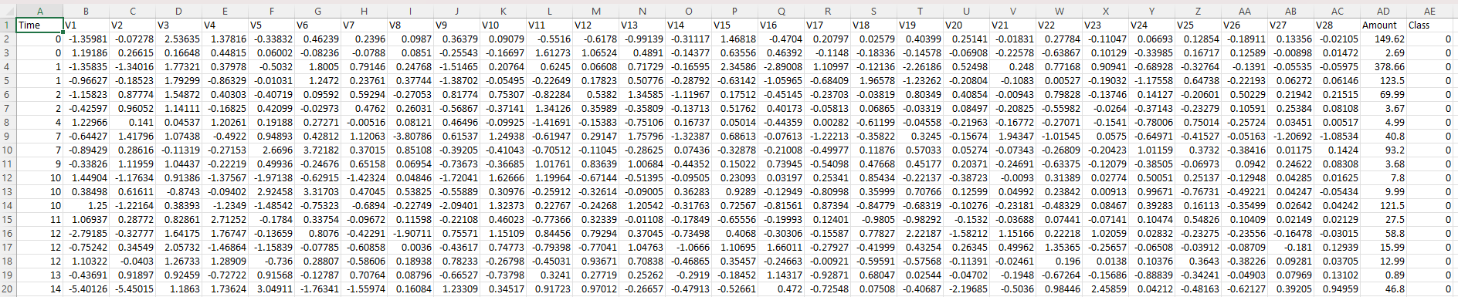
DATA SET:
This is the data set that we have taken for the project.
It has 284808 rows and 30 columns.
Size of the data set 143mb.
https://www.kaggle.com/datasets/mlg-ulb/creditcardfraud

Slide 15
WORKFLOW:
Testing Set
20%
Credit card Transactions Data
80%
Training Set
Apply Algorithm
Model Evaluation

Slide 16
HARDWARE USED:
OS Microsoft Windows 11 Home Single Language
PROCESSOR Intel(R) Core(TM) i5-10300H CPU @ 2.50GHz, 2496 Mhz, 4 Core(s), 8 Logical Processor(s)
SSD 512GB PCIe® 3.0 NVMe™ M.2 SSD
RAM 8.0 GB
GPU NVIDIA® GeForce GTX™ 1650, 4GB GDDR6

Slide 17
LIBRARY USED:
Numpy
Pandas
Matplotlib
Seaborn
Sklearn
Imblearn

Slide 18
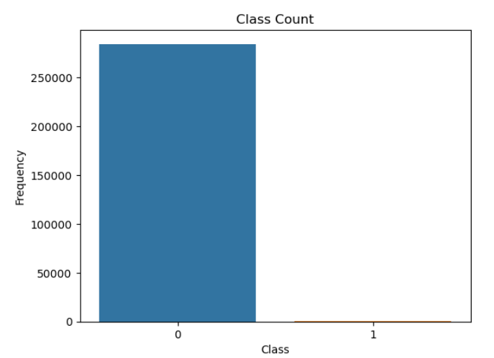
DATA VISUALIZATION:
Here 0 represents Normal transaction.
1 represents fraud transaction.

Slide 19
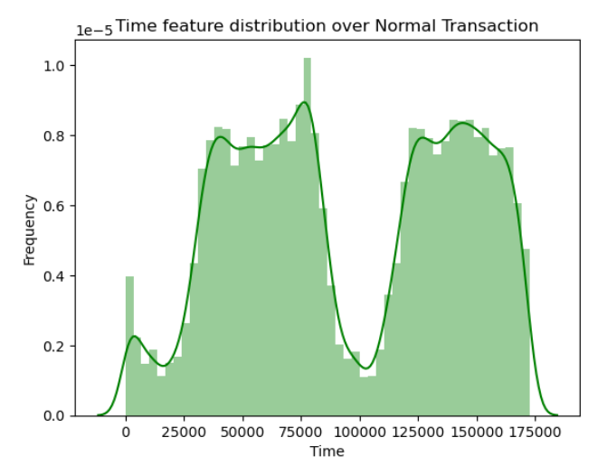
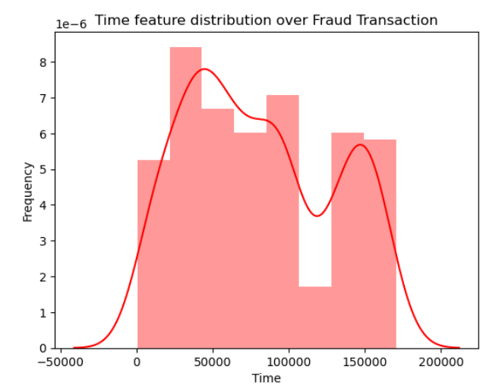
Time feature distribution over Normal & Fraud Transaction

Slide 20
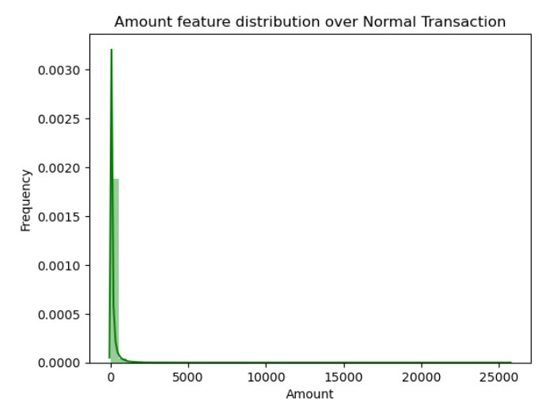
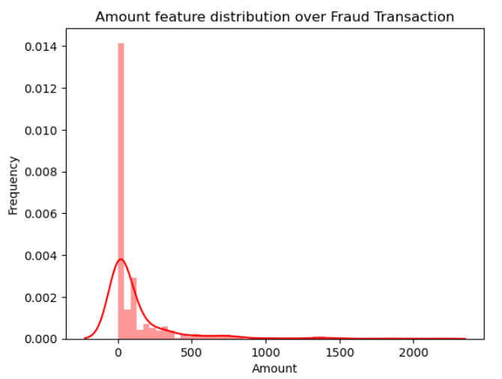
Amount feature distribution over Normal & Fraud Transaction

Slide 21
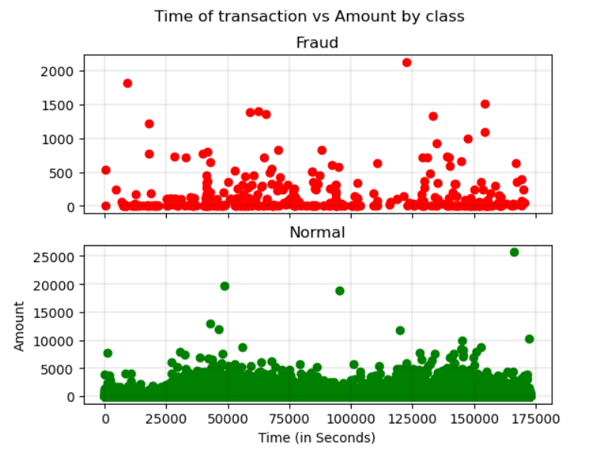
Time of transaction vs Amount by class

Slide 22
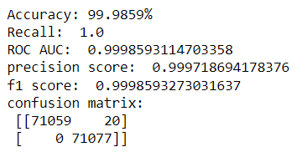
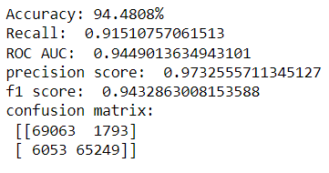
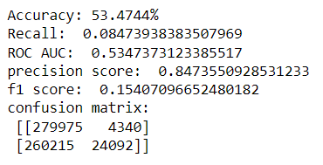
PERFORMANCE SCORE OF MODELS:
Random Forest
Logistic Regression
K-means Clustering

Slide 23
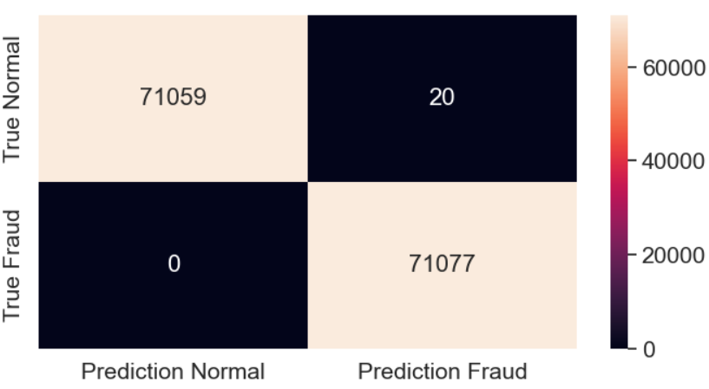
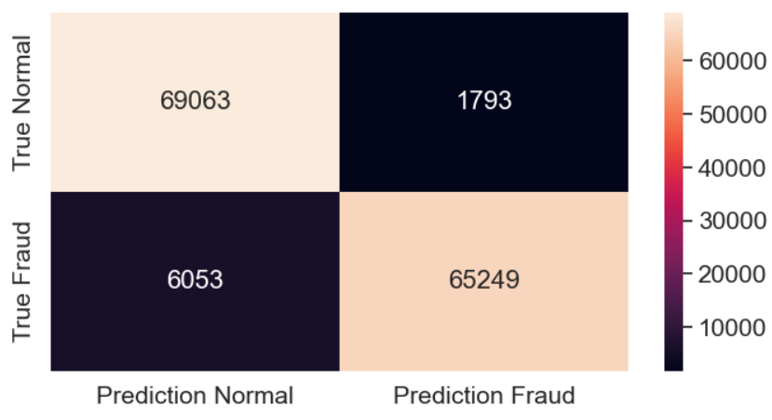
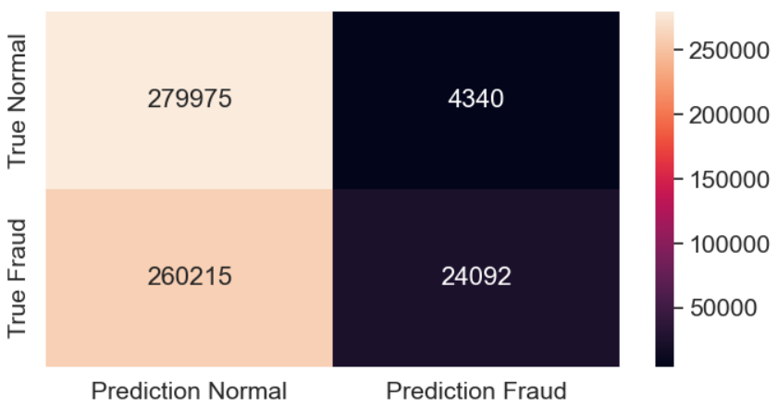
CONFUSION MATRIX HEATMAP OF MODELS:
Random Forest
Logistic Regression
K-means Clustering

Slide 24
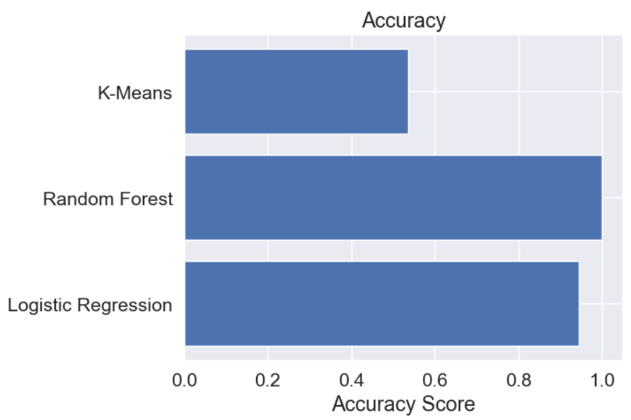

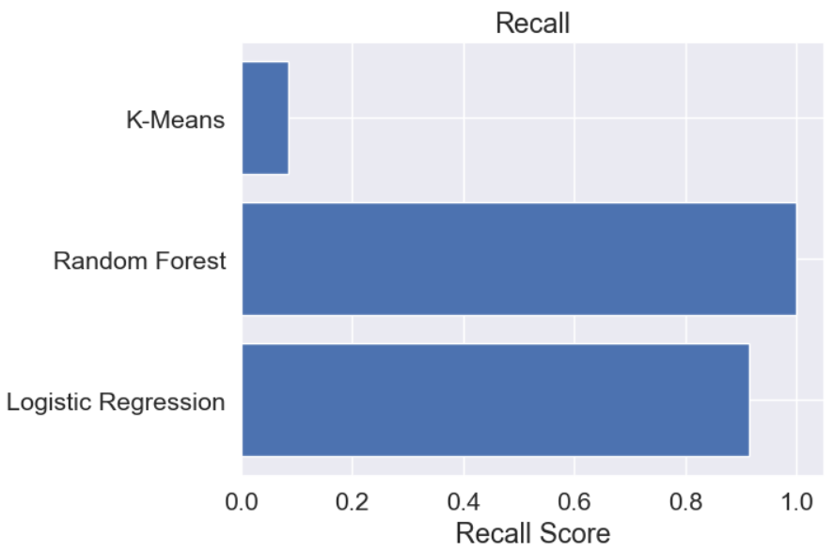
Accuracy score , AUC score , Recall score of all algorithms that we have used.

Slide 25
RESULT & DISCUSSION:
Models | Accuracy | Recall | ROC AUC | Precision Score | F1 Score
Random Forest | 99.98% | 1.0 | 0.99 | 0.99 | 0.99
Logistic Regression | 94.48% | 0.91 | 0.94 | 0.97 | 0.94
K-means Clustering | 53.47% | 0.08 | 0.53 | 0.84 | 0.15
The above table shows the accuracy , recall, roc auc , precision score & f1 score of the algorithms.

Slide 26
CONCLUSION:
After getting the result we observed them thoroughly and came to a conclusion that the Random Forest Algorithm has the best accuracy & performance than Logistic Regression & K-means Classifier.
Random Forest > Logistic Regression > K-means Classifier
(99.98%) (94.48%) (53.47%)
Therefore the Random Forest algorithm model is the best model for detecting frauds in Credit Cards.

Slide 27
REFERENCES:
J.Pun (19 dec 2011). Improving Credit Card Fraud Detection using a Meta-learning Strategy.
Aisha Fayyomi, Derar Eleyan (2021). Article in International Journal of Scientific & Technology Research. A Survey Paper On Credit Card Fraud Detection Techniques.
S. H. Projects and W. Lovo, ―JMU Scholarly Commons Detecting credit card fraud : An analysis of fraud detection techniques,‖ 2020.
S. G and J. R. R, ―A Study on Credit Card Fraud Detection using Data Mining Techniques,‖ Int. J. Data Min. Tech. Appl., vol. 7, no. 1, pp. 21–24, 2018, doi: 10.20894/ijdmta.102.007.001.004.

Slide 28
THANKYOU!

